Slide 1
RREF v.s. Span
Notes:
從 RREF 一眼看出 rank
為什麼死神的聖物有三樣

Slide 2

Consistent or not
Given Ax=b, if the reduced row echelon form of [ A b ] is
Given Ax=b, if the reduced row echelon form of [ A b ] is
Consistent
b is in the span of the columns of A
inconsistent
b is NOT in the span of the columns of A
$$0∙x_{1}+0∙x_{2}+0∙x_{3}=1$$

Slide 3
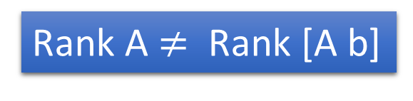


Consistent or not
Ax =b is inconsistent (no solution)
The RREF of [A b] is
$$\left[\begin{matrix}\begin{matrix}∗ & ∗ & ∗ \\ ∗ & ∗ & ∗ \\ ∗ & ∗ & ∗\end{matrix} & \begin{matrix}∗ & ∗ & ∗ \\ ∗ & ∗ & ∗ \\ ∗ & ∗ & ∗\end{matrix} \\ \begin{matrix}0 & 0 & 0 \\ 0 & 0 & 0 \\ 0 & 0 & 0\end{matrix} & \begin{matrix}0 & 0 & d \\ 0 & 0 & 0 \\ 0 & 0 & 0\end{matrix}\end{matrix}\right]$$
Only the last column is non-zero
$$d≠0$$
3
4
Rank A $≠$ Rank [A b]
Need to know b

Slide 4
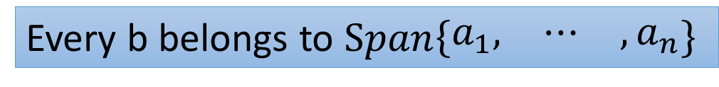


Ax =b is consistent for every b
$$A:m×n$$
=
Every b is in the span of the columns of A$=\left[\begin{matrix}a_{1} & ⋯ & a_{n}\end{matrix}\right]$
=
Every b belongs to $Span\left\{\begin{matrix}a_{1}, & ⋯ & ,a_{n}\end{matrix}\right\}$
=
$Span\left\{\begin{matrix}a_{1}, & ⋯ & ,a_{n}\end{matrix}\right\}=R^{m}$
=
RREF of [A b] cannot have a row whose only non-zero entry is at the last column
=
RREF of A cannot have zero row
沒有任何破綻
=
Rank A = no. of rows

Slide 5

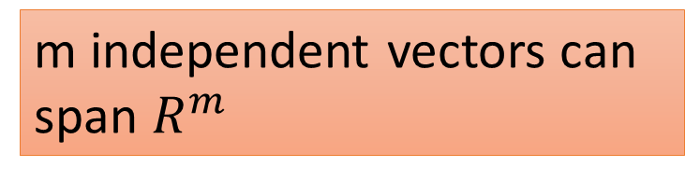

Consistent or not
$$A:m×n$$
$Span\left\{\begin{matrix}a_{1}, & ⋯ & ,a_{n}\end{matrix}\right\}=R^{m}$
=
Rank A = no. of rows
m independent vectors can span $R^{m}$
More than m vectors in R^{m} must be dependent.

Slide 6
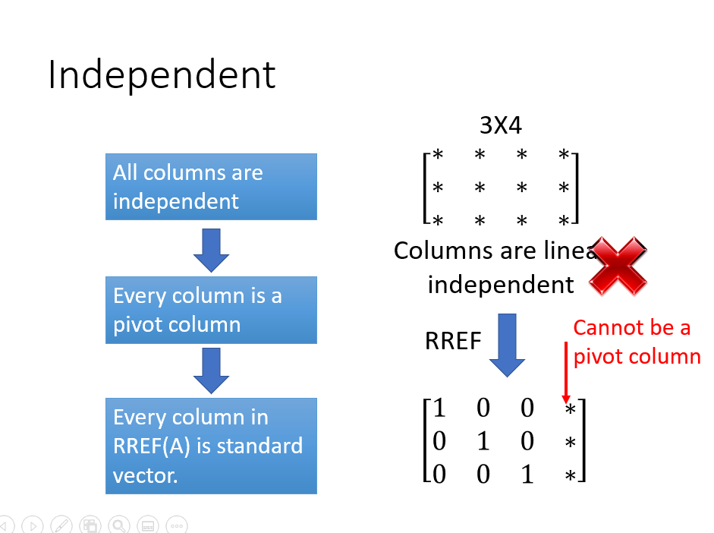
這個發現已經提過，現在只是從 span 的觀點再說一次

Slide 7
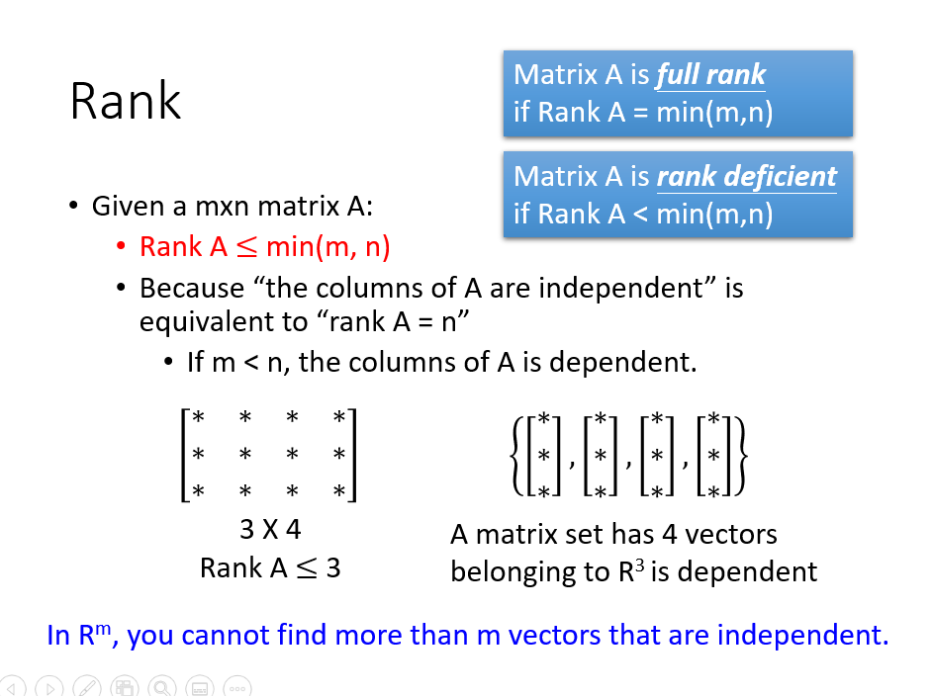
這個發現已經提過，現在只是從 span 的觀點再說一次

Slide 8




Example
m independent vectors can span $R^{m}$
$$a$$
Consider R²
$$b$$
$$c$$
yes
independent

Slide 9
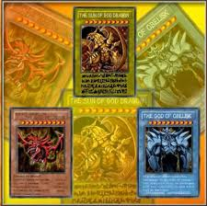
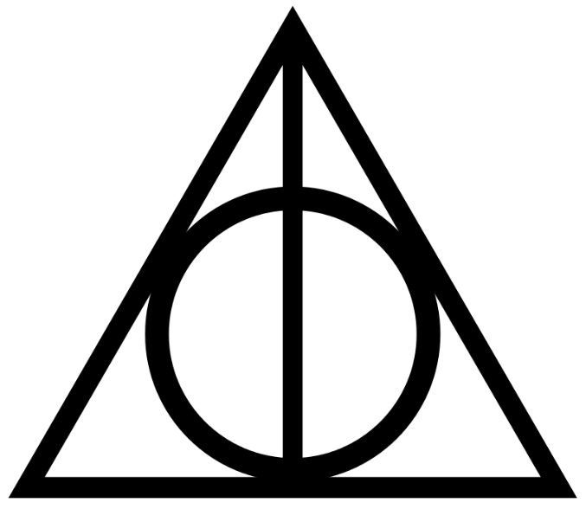

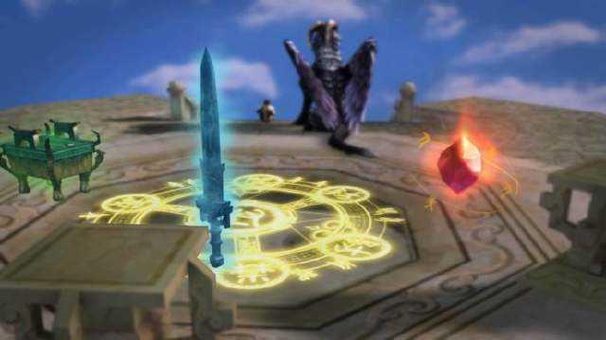
Notes:
我們生活在三維空間
三是特別有
三足鼎立

